Slide 1



Blockchain and Its Application
Lecture # 1:
Basic Security Concept
This Photo by Unknown Author is licensed under CC BY

Slide 2
Topic Agenda
What is security
Security in Application
Concept of CIA
CIA is used for Application
Confidentiality Algorithms
Integrity Algorithm
Availability
What is Centralize Security
Implement the Usecase of Centralize Security

Slide 3
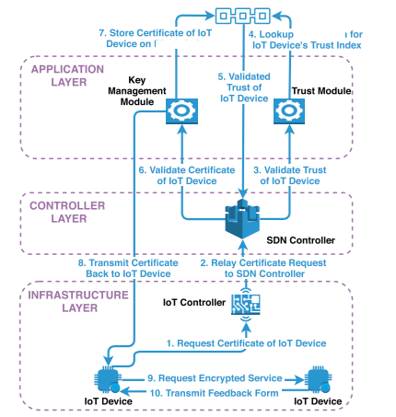
What is Security?
  Protection of systems, networks, and data from unauthorized access or harm.
  Encompasses confidentiality, integrity, and availability (CIA).
Goal:
  Ensure trust, reliability, and resilience of systems.

Slide 4
Security in Applications
Why Application Security Matters?
  Prevents breaches and data loss.
  Protects sensitive information (e.g., financial, personal).
Use Case:
  Digital transaction data such as Banking Sector
Key Challenges:
  Code vulnerabilities
  Insider threats and human errors.
Give Example of Data breaches and data loss by considering previous
Give Example

Slide 5
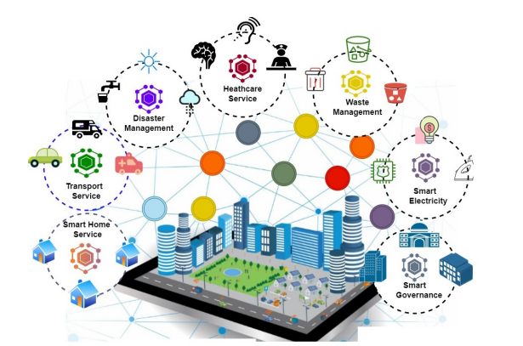
Smart Cities
Made up of multiple smart services.
Purpose is to enhance living standard
Implementation is possible with the help technological adaptation such as Blockchain,AI, machine learning
Interoperable Smart Service
Routine task in the form digital service
Able to sharing data and resources
The driving force use sensors , devices standard APIs use to make service
Multiple communication standard
Figure-1 Smart Cities-eco system
Smart Cities | Smart Services
Singapore [1,2] | Smart transportation, smart energy management
Barcelona [3] | Smart Infrastructure, Citizen Engagement
Dubai [4] | Smart transportation
Table-1:Smart Cities with Smart Services

Slide 6

Collaborative Services Environment
Cooperation of multiple interoperable services during interoperability in smart city ecosystem
OnSolveCodeRED Collaborative Services[5]
Interoperability platform
Made of multiple smart APIs
One of the core service is to execute emergency response system
Highlighted Collaborative task
Inform the specific geographic areas affected
by an rains and floods
Figure-2
Smart Cities Collaborative Services
Environment
https://www.synox.io/en/our-iot-achievements/use-cases/catalog-use-cases-smart-city/
Protect sensitive information and secure data flow mechanism of interoperable service during interoperability

Slide 7
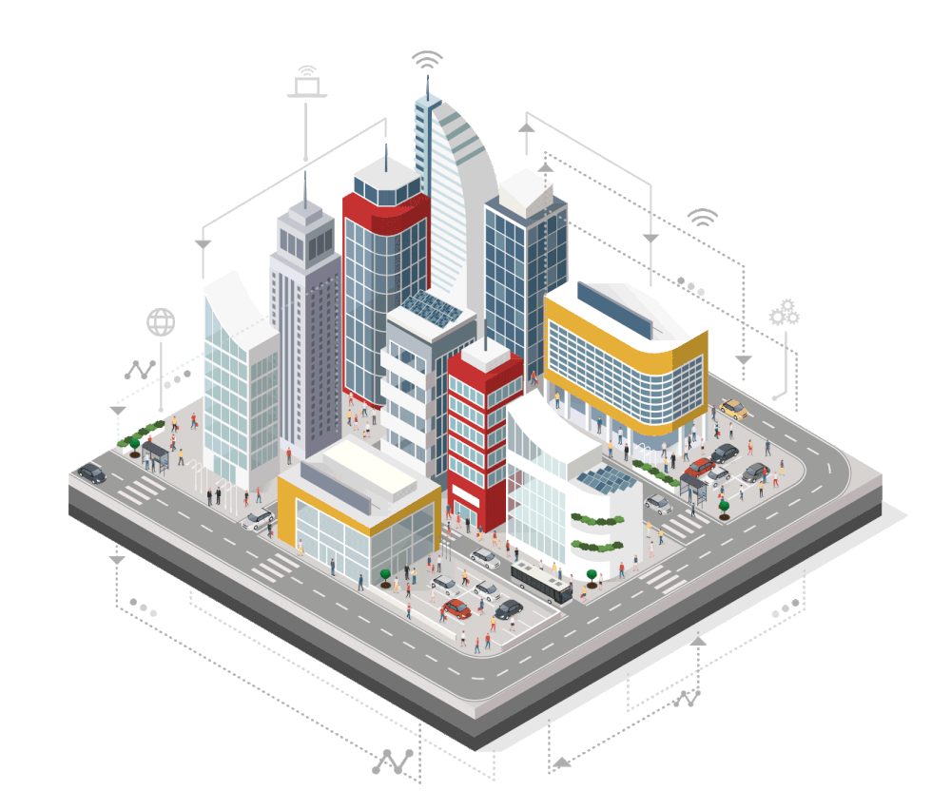
2. Security Challenges
The security challenges that need to considered
Access Level
Information Security
Adaptive security governance

Slide 8
Access Level Security
Process of Request /Response when the user of interoperable service want use the service it perform three steps
Authentication
Process of verifying the identity of individuals or devices (Username, Password, Digital signature,PKI)
Authorization
Process of determine the role of particular identity or devices(ABAC,RBAC)
Access Control
Process to allocate the request of resource to user of the service
Challenges
Ensuring consistent access control policies
across different interoperable services
Ensuring consistent authorization policies
across different interoperable services
Security Challenges

Slide 9
Challenges
Ensuring Secure data flow mechanism between different interoperable services
Maintaining trust in the data of interoperable services
Confidentiality
Process to provide security to the message and the dataflow for unauthorized disclosure (ECC, RSA,AES)
Integrity
Process to prevent unauthorized tampering or modification of data (SHA-256,SHA-1)
Availability
Accessibility and availability required service
Information Security
Secure the data flow of interoperable services and across domain
Security Challenges
2. Security Challenges

Slide 10
Adaptive Security Governance
Related with security governance
Security Governance
Management of security rules and policies for interoperable service when sharing data with each other through interoperability
Adaptive Security Governance
Mechanism to monitor all the changes in the security rules and policies ensure that all the connected modules in the ecosystem will able to adapt these changes
Challenges
Creating Adaptive ecosystem when different interoperable services sharing the data with each other and having different security requirement
Security Challenges
2. Security Challenges
2. Security Challenges

Slide 11
What is Centralized Security?
Definition:
  Security controlled by a central authority or system.
Advantages:
  Simpler management.
  Easier enforcement of policies.
Challenges:
  Single point of failure.
  Limited scalability.

Slide 12
Blockchain and Its Application
Lecture # 2:
Centralize
Security Concept
This Photo by Unknown Author is licensed under CC BY

Slide 13
Centralize Security Component
Security Solution Embedding
Cryptographic primitive
Hash Functions
Public Key cryptography

Slide 14
These modules play the vital roles in centralize security solution
1
2
Policy engine
3
Context Engine
Rule Engine
Defining access level ,information security requirement in the form of security rules for interoperable services during interoperability
Define high level definition to security rules in the form of defining roles of legitimate user of Interoperable services
Responsible for making contextual information of security rules and policies for interoperable service for service execution

Slide 15
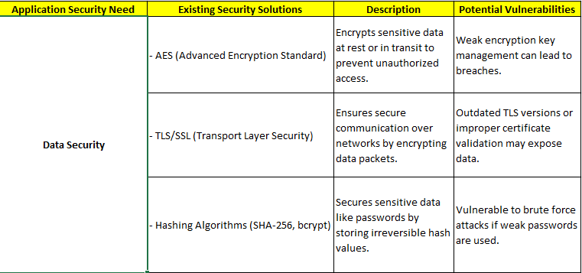
Security Solution Embedding

Slide 16
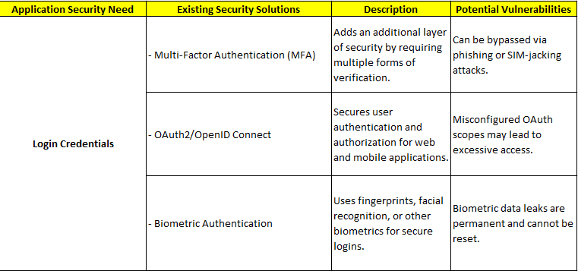
Security Solution Embedding

Slide 17
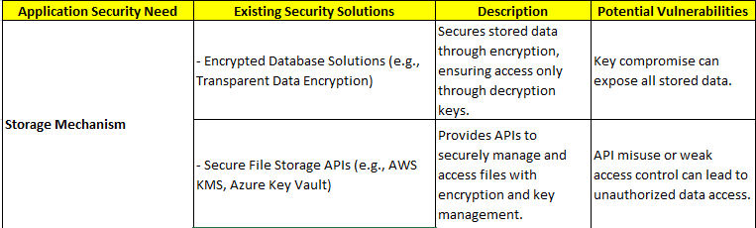
Security Solution Embedding

Slide 18
Overview
Cryptographic Hash Functions
Public Key Crypto
RSA vs ECC
Digital Signatures
Hash Pointers
Merkle Trees
Block Structure and Chains

Slide 19
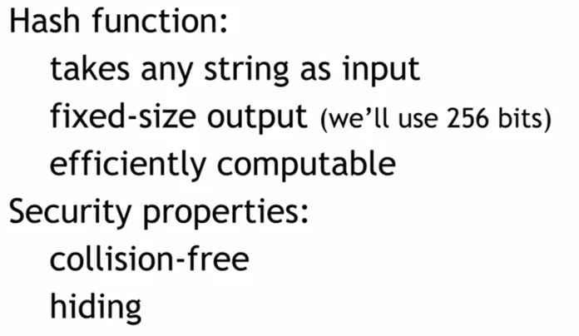

Slide 20
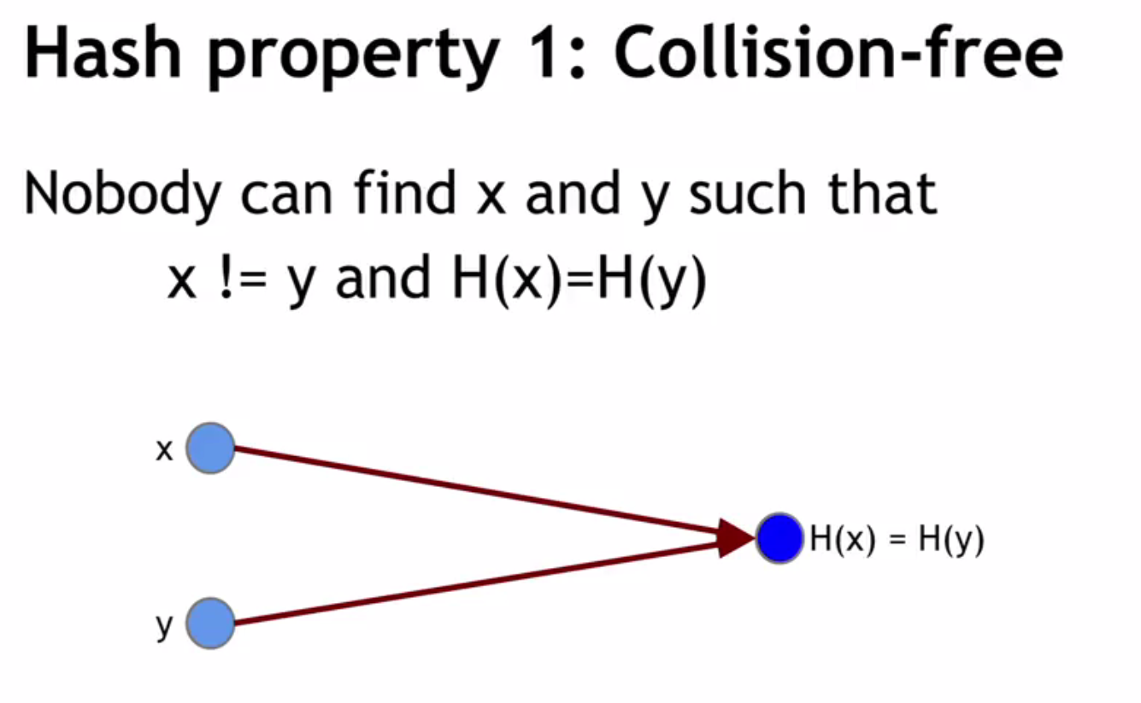
Example x=Shahbaz
Y=Shahbaz 2
H(x)=123
H(y)=1234

Slide 21
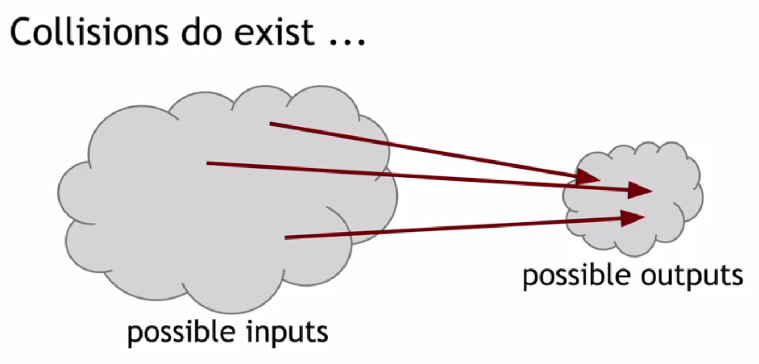

Slide 22
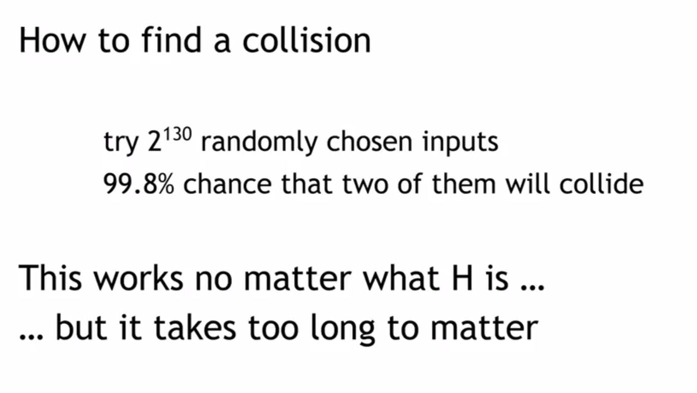
Example x=Shahbaz
Y=Shahbaz 2

Slide 23
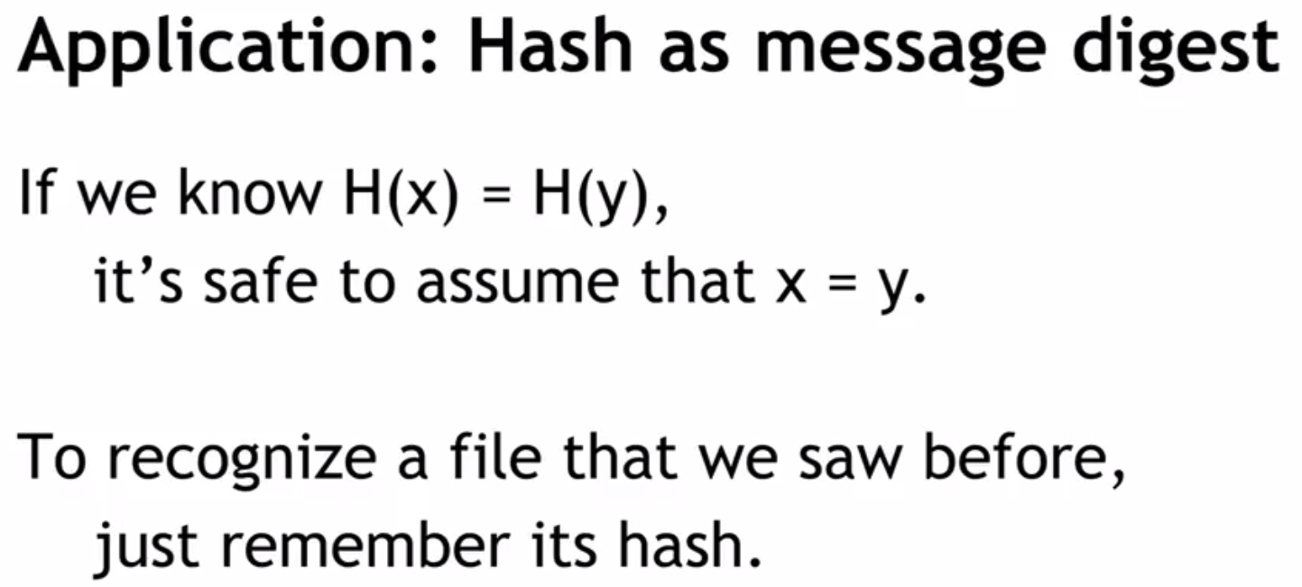
1.Signature
2.Verification (Alteration of File )
3.Puzzel Purpose

Slide 24
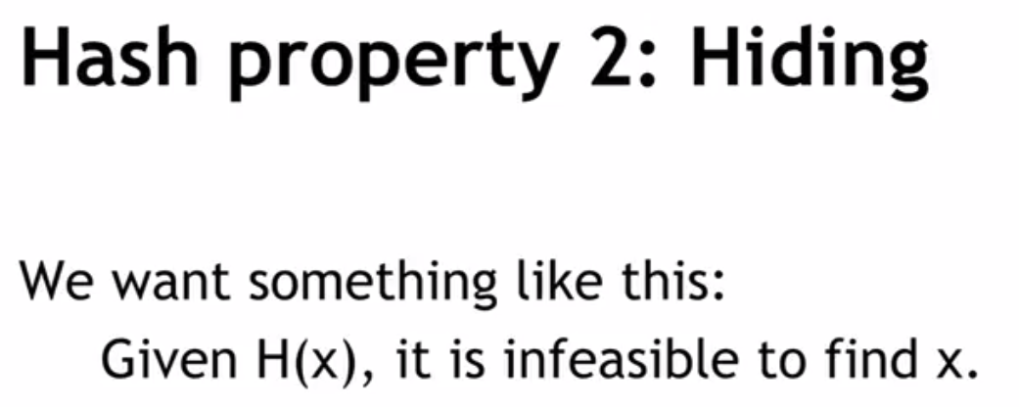
Puzzel
1000000…..1……0001

Slide 25
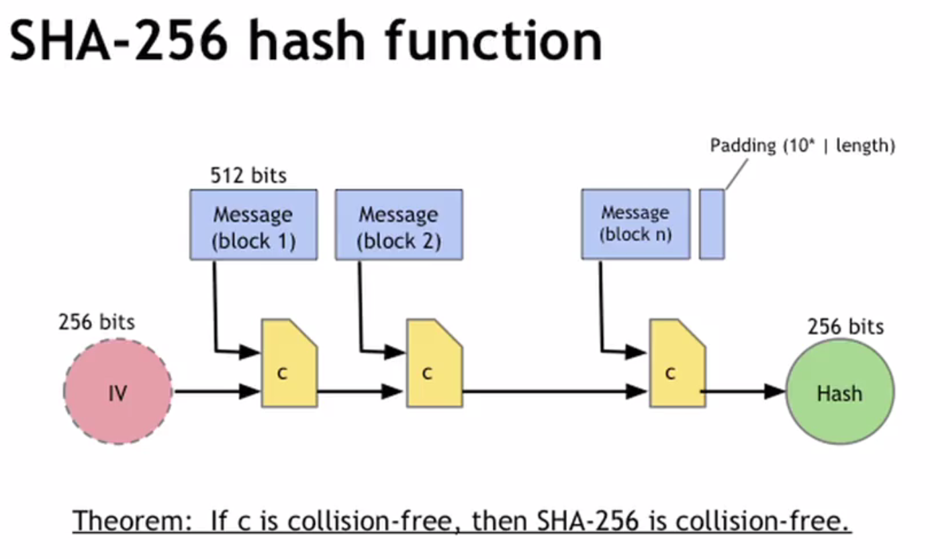
Shah
Baz0
0010
1010001
0010ADVC

Slide 26
Blockchain and Its Application
Lecture # 3:
Centralize
Security Concept
This Photo by Unknown Author is licensed under CC BY

Slide 27
Cryptographic primitive
Hash Functions
Public Key cryptography
Data Structure for Security

Slide 28
Public Key Cryptography

Slide 29
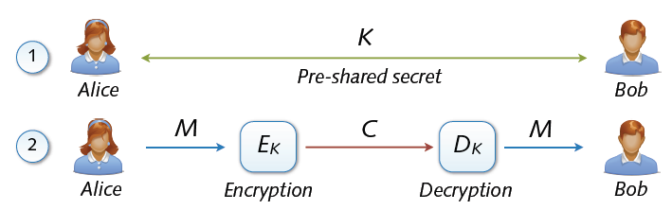
Symmetric cryptosystems
Precondition: secure exchange of keys in advance
  Paradox situation at a first glance
  secure communication depends on secure key exchange
1.Required Keys
2.We Require Many keys
3.Concept of Digital certificate

Slide 30
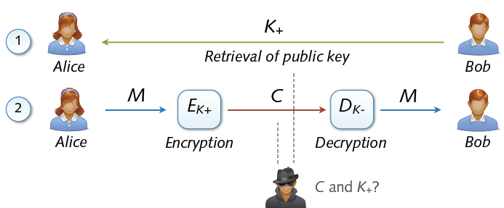
Asymmetric Cryptosystem
Asymmetric cryptosystems
  Asymmetric encryption and decryption
  K+ (pk) = public key of Bob K– (sk) = secret key of Bob
  No secure key exchange necessary

Slide 31
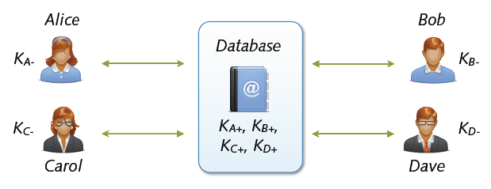
Key Exchange with Public Keys
Scalable communication with multiple parties
  Linear number of exchanges: n parties → n public keys
  Real-world systems with millions of keys (e.g. PGP)
  ... for the moment everything is fine
Hack

Slide 32
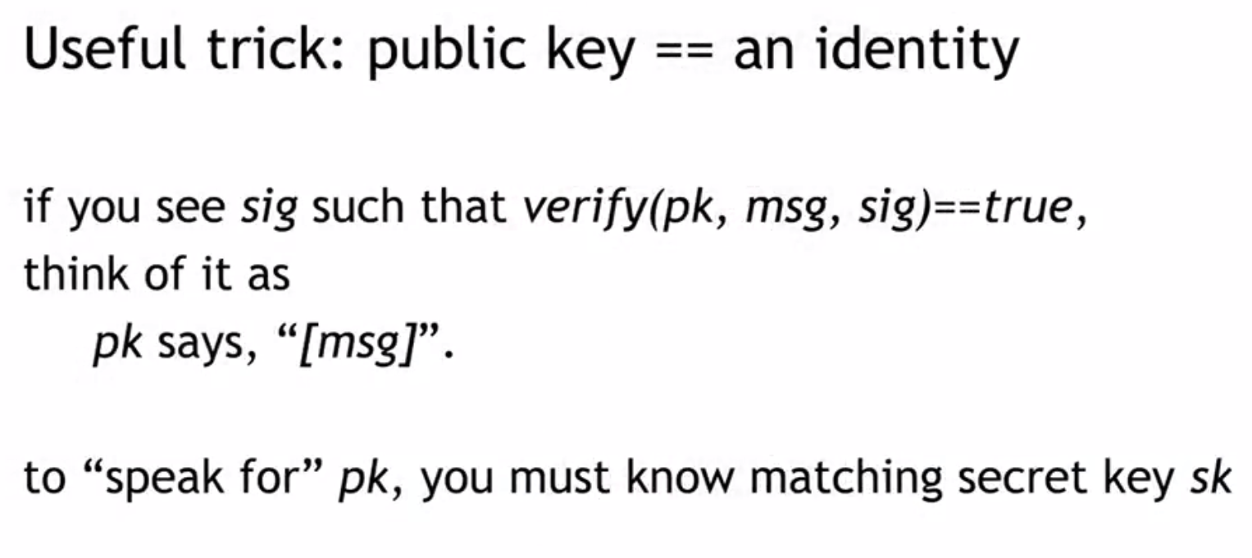

Slide 33
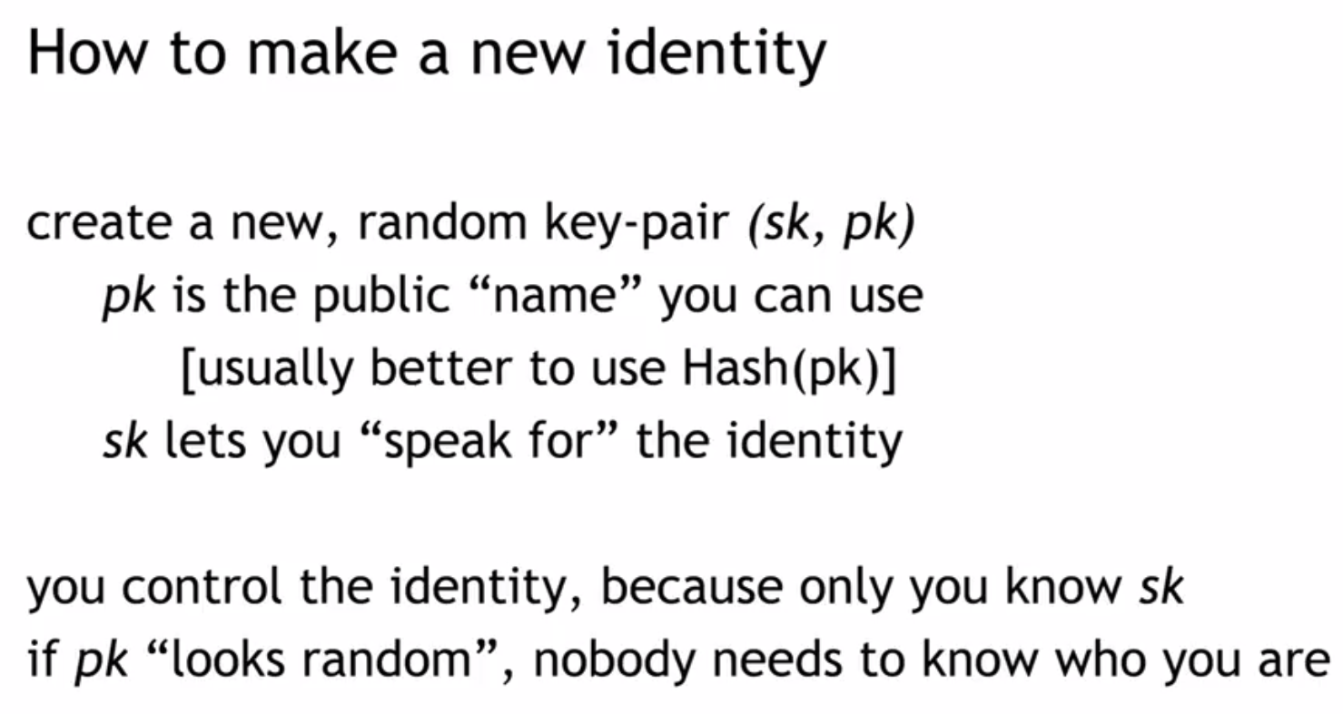

Slide 34
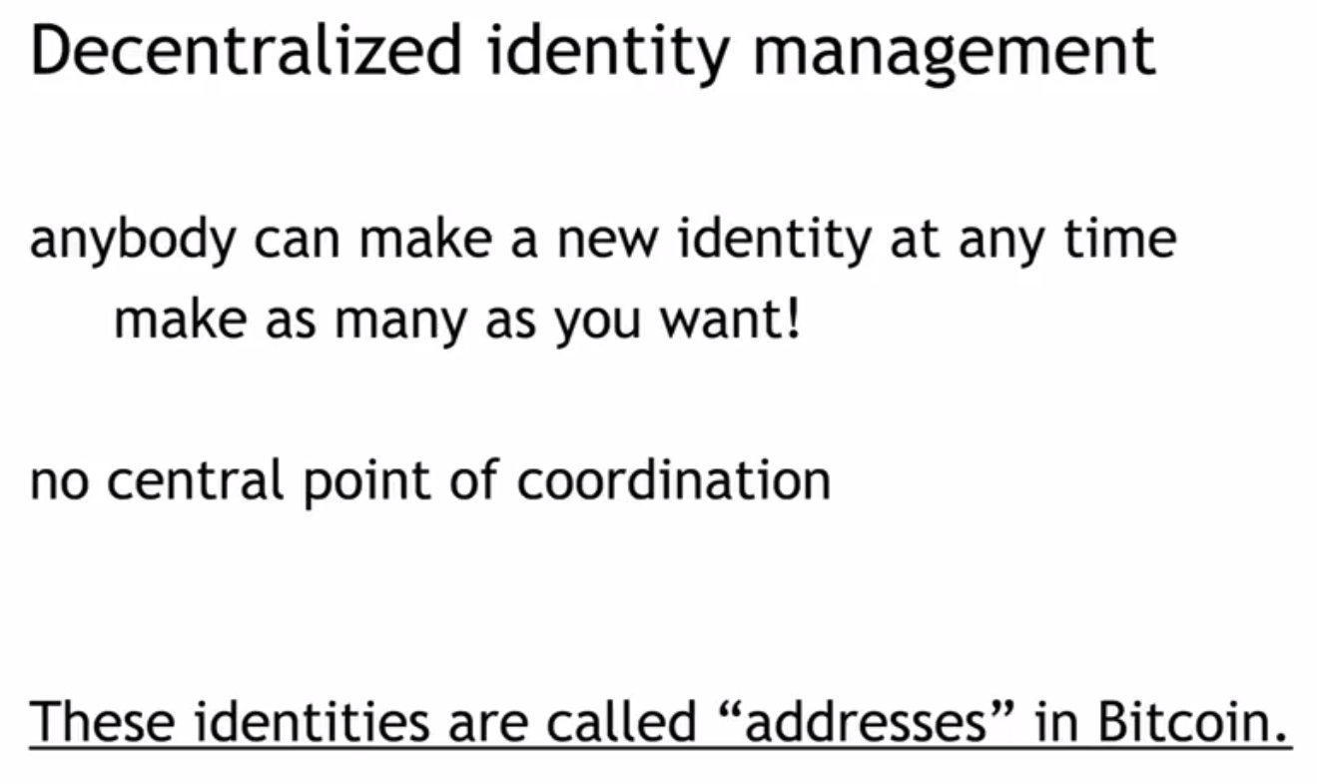

Slide 35
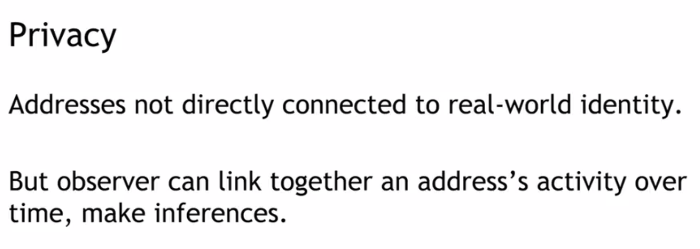

Slide 36
Digital Signatures

Slide 37
Digital Signature
Authentication and Non-Repudiation
  Gives a recipient reason to believe that the message was created by a known sender such that they cannot deny sending it
Integrity
  The message was not altered in transit
Notes:
Non-repudiation refers to a state of affairs where the purported maker of a statement will not be able to successfully challenge the validity of the statement or contract

Slide 38
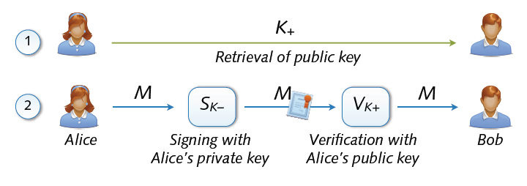
Digital Signature
Digital signing: reverse application of public-key system
  Signing = encryption with private key
  Verification = decryption with public key

Slide 39
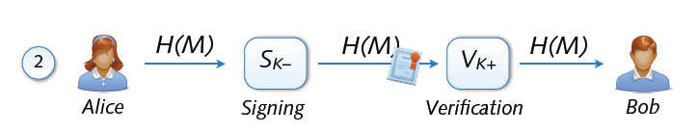
Signing and Hashing
Encryption and decryption of large messages inefficient
  Signing of hash H(M) instead of message M
  Verification of message M using signed hash H(M)
  One-way property: hard to find M’ with H(M’) = H(M)
  Support for signing emails, images, videos, ...

Slide 40
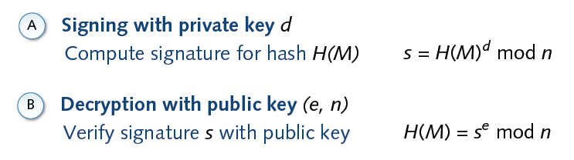
Signature and RSA

Slide 41
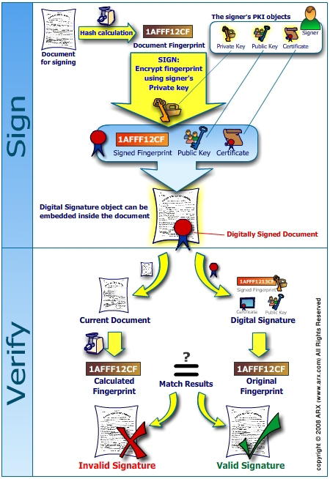
`

Slide 42
Data Structures for Security
Data structures play a significant role in implementing secure systems by organizing and managing data efficiently while ensuring confidentiality, integrity, and availability. Here are key data structures commonly used in security applications:
Linked List , Array , Tree , Binary Tree , Merkel Tree ……

Slide 43
Linked List in Security
A linked list is a linear data structure where each element (node) contains data and a reference (or pointer) to the next node in the sequence. From a security perspective, linked lists can be utilized in scenarios where dynamic and flexible memory management is critical.
Imagine you're managing a system for tracking student activities in a secure and tamper-proof way. For example, each time a student completes a quiz, submits an assignment, or participates in a club activity, you want to record that activity. You also want to ensure that no one can tamper with the records, ensuring the integrity of the data.
Here's how the system works:

Slide 44
Pre Next
Pre Next
Pre Next
Pre Next
Data 1
Posted By
A1
Data 1
Posted By
A2
Data 1
Posted By
A1
Data 1
Posted By
A3
Challenge -1
A1 can its data only
A2 can see its data only
A3 Can See it data
Challenge -2
Public and private Keys mechanism
Challenge -3
Who is responsible to maintain the address of Linked List
Solve with filtering and conditional checks

